Slide 1
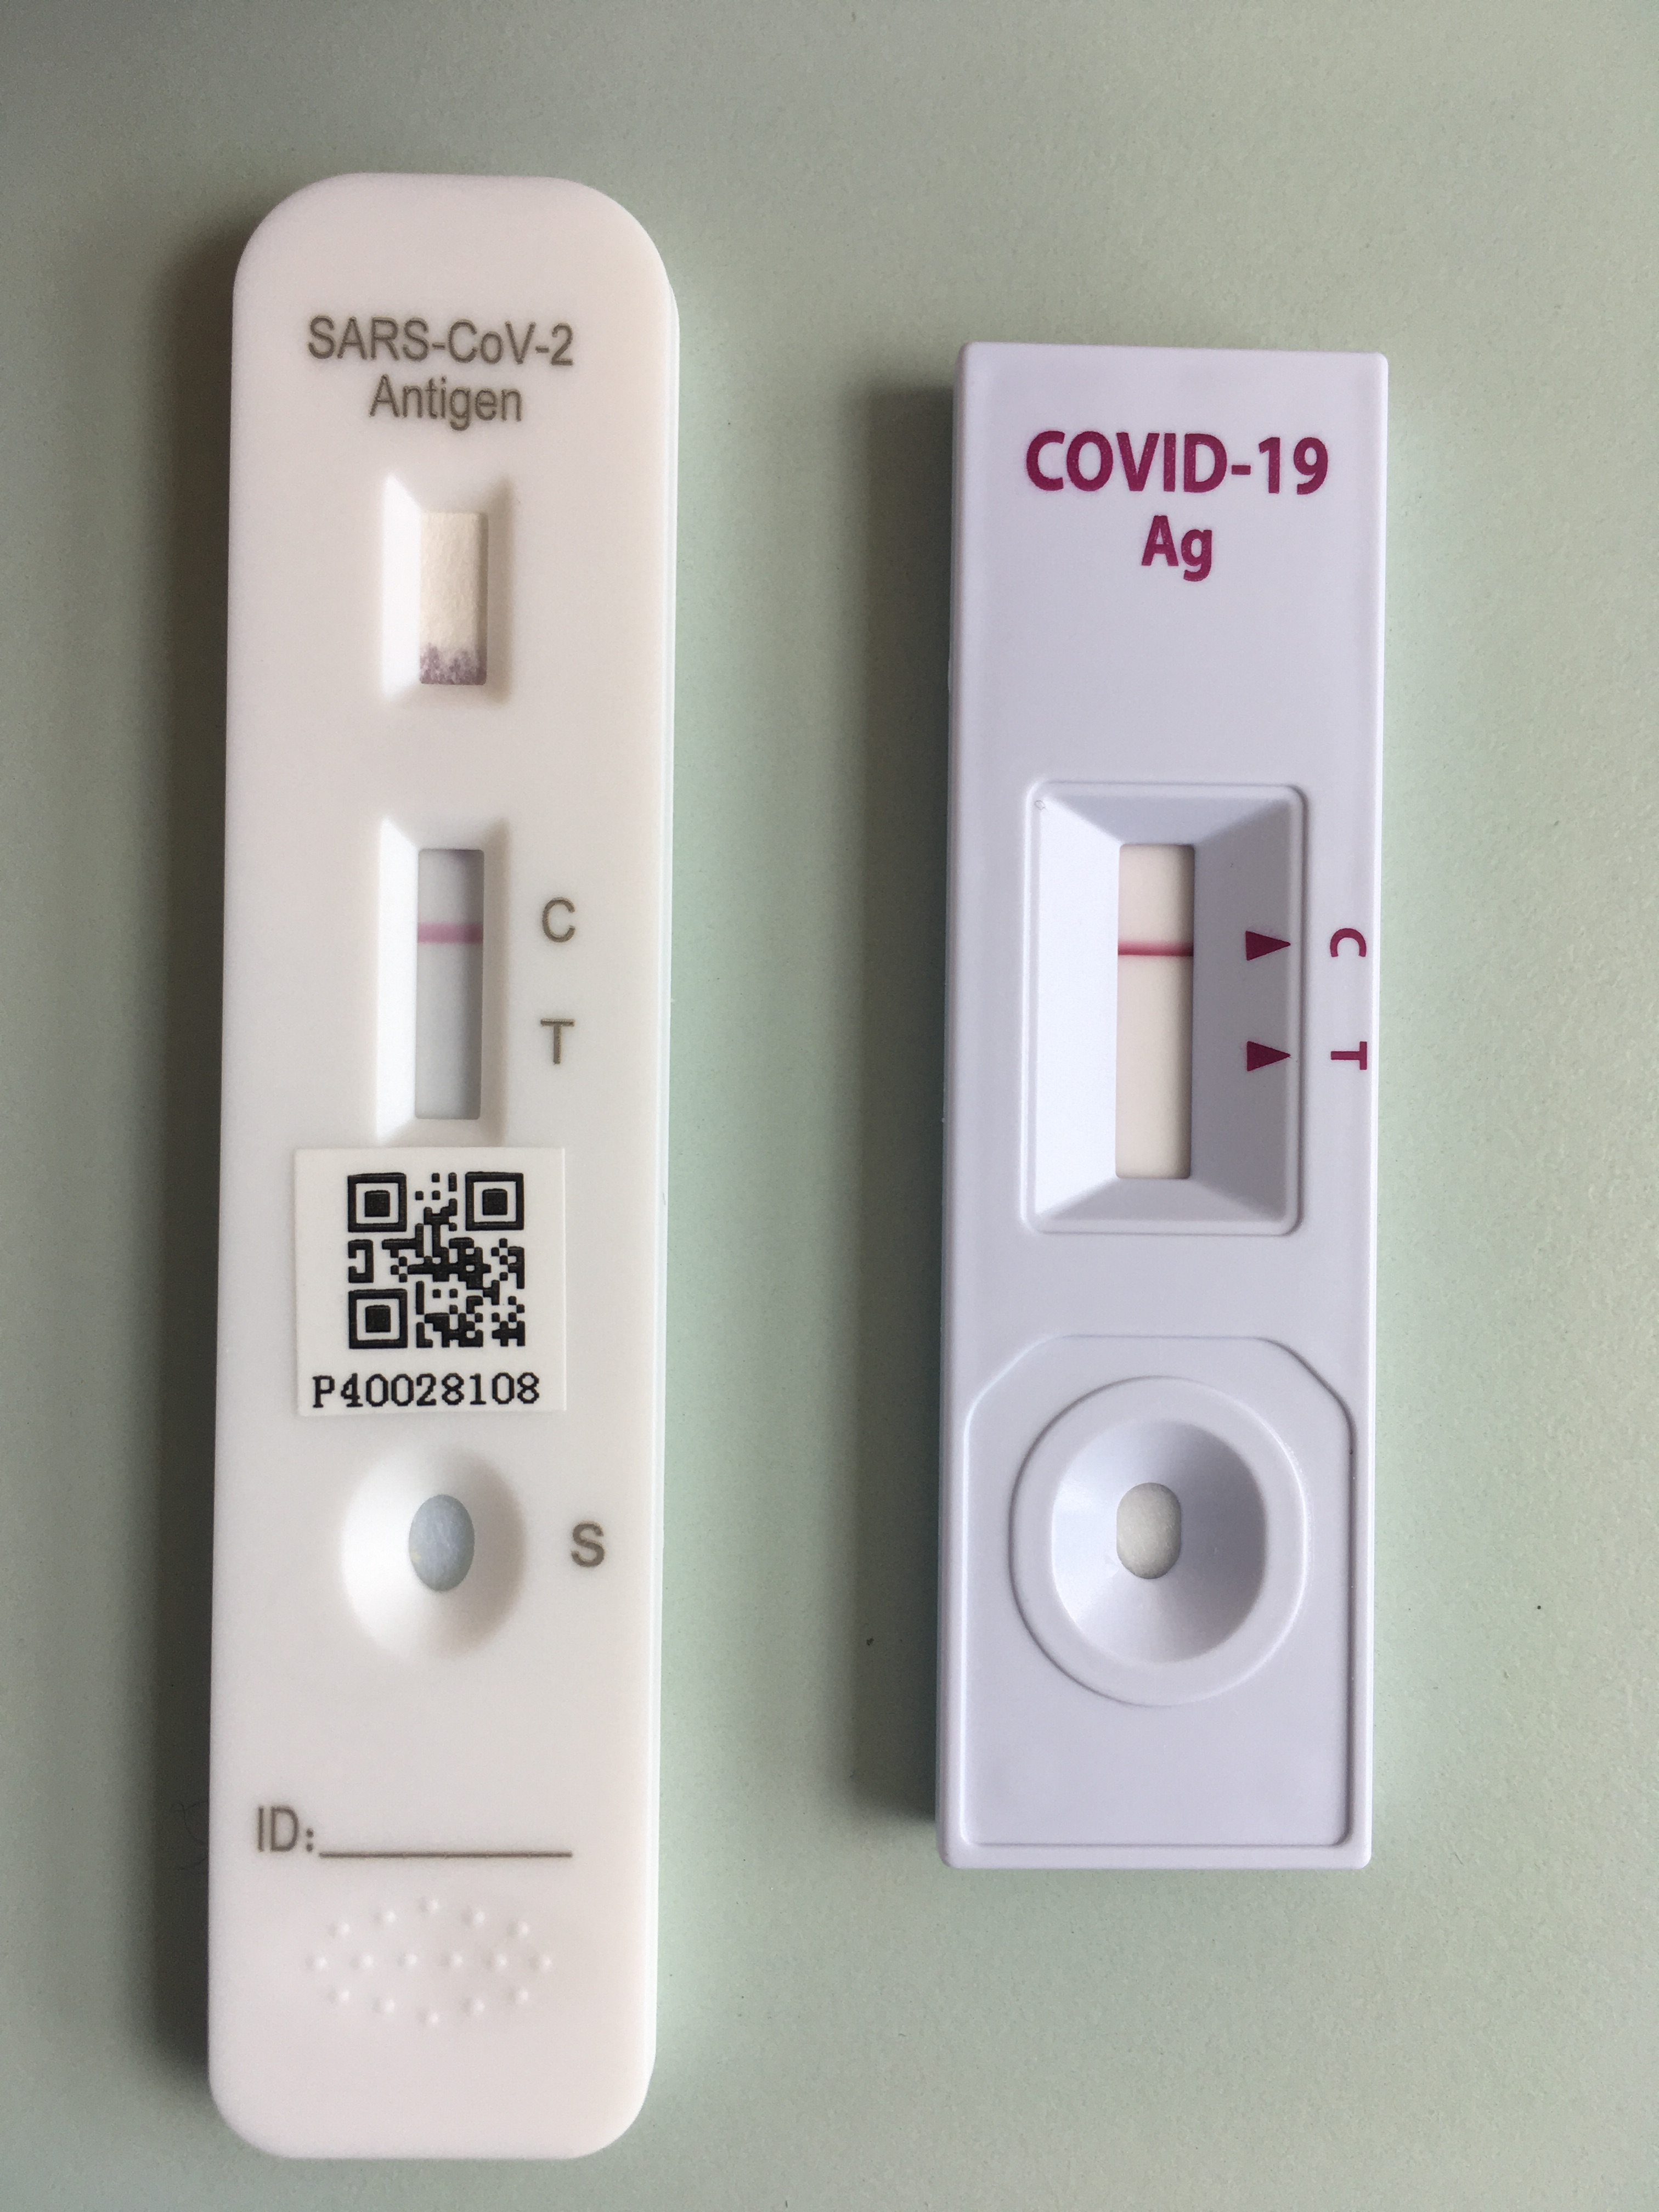
Workplace RAT Tracker
Problem
Business Value
An increasing number of workplaces such as schools, aged care facilities and healthcare providers are now required to ensure staff are regularly tested against COVID-19 using RATs
This introduces additional administration for workplaces who need to track and validate the results of these tests
Reduce administration costs
Ensure regulatory compliance – avoid penalties
Scope
As an administrator, I want to be able keep track of RAT test results
As an employee, I want to be able to submit my RAT test result without much hassle
Personas
Workplace Administrators
Employees

